Slide 1
Detection of spam emails
Nadimpalli Ramana kumar varma

Slide 2
Domain understanding.
Anonymity: The address and identity of the sender are concealed
Mass Mailing: The email is sent to large groups of people
Unsolicited: The email is not requested by the recipients

Slide 3
HOW to detect spam emails
Based on the frequency of certain words and the capital letters occurring in the spam emails we will be able to detect whether the email is spam.

Slide 4
The most common EXAMPLES OF spam words

Slide 5
DATA EXPLORATION AND PRE-PROCESSING
Variable Identification
Univariate Analysis
Bi-variate Analysis
Missing values treatment
Outlier treatment
Feature engineering
Standardize the data.

Slide 6
Variable identification
PREDICTOR VARIABLES
There are 48 continuous attributes which represent the percentage of words in the e-mail that match WORD.
There are 6 continuous attributes which percentage of characters in the e-mail that match CHAR.
There is 1 continuous attribute which is the average length of uninterrupted sequences of capital letters.
There is 1 continuous attribute which is the length of longest uninterrupted sequence of capital letters.
There is 1 continuous attribute which is the sum of length of uninterrupted sequences of capital letters .
TARGET VARIABLES.
There is one class attribute whether the email is spam .

Slide 7
PROPORTION OF CLASS
NNO – NOT A SPAM EMAIL.
YES – SPAM EMAIL.

Slide 8
Univariate Analysis

Slide 9
MULTIVARIATE ANALYSIS

Slide 11
MISSING VALUE TREATMENT
Luckily there are no missing values in the given data

Slide 12
FEATURE ENGINEERING
FEATURES WITHOUT PCA.
FEATURES WITH PCA.
IMPORTANT FEATURES FROM RANDOOM FOREST.
IMPORTANT FEATURES AFTER LASSO REGULARISATION.
IMPORTANT FEATURES AFTER ELIMINATING NEAR ZERO VARIANCE FEATURES

Slide 13
IMPORTANT TEST METRICS
SPECIFICITY SHOULD BE HIGH SINCE MARKING A GOOD EMAIL AS SPAM IS HIGHLY INTOLERABLE.
OVERALL ACCURACY METRIC IS A GOOD MEASURE.

Slide 14
List of machine learning algorithms used.
LOGISTIC REGRESSION MODEL.
SUPPORT VECTOR MACHINE-LINEAR AND NON LINEAR.
RANDOM FOREST
KNN CLASSIFIER
GBM
CART
BAGGING
C 5.0
ENSEMBLES.

Slide 15
LIST OF LIBRARIES USED IN R PROGRAMMING
caret
MASS
ROCR
gplots
e1071
gbm
rpart
Ipred
C50
mxnet
randomForest
doMC

Slide 16
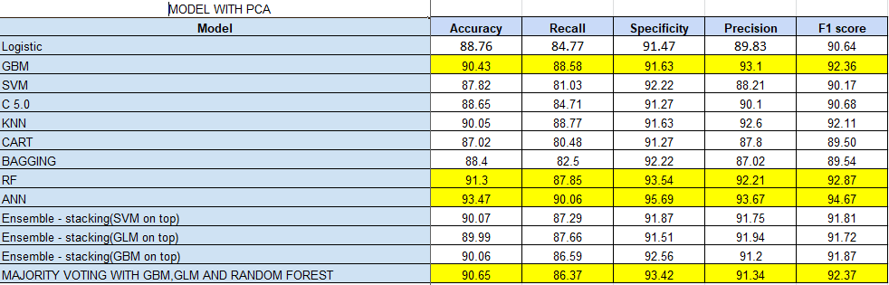
Test metric

Slide 17
Test metric

Slide 18
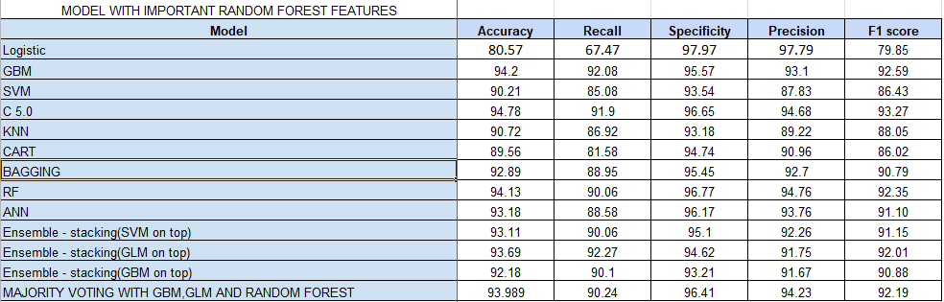
Test metric

Slide 19
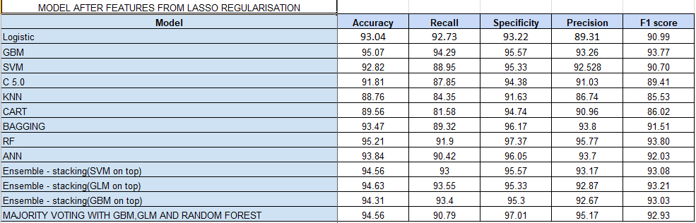
TEST METRIC

Slide 20
BEST MODEL
MAJORITY VOTING WITH GBM , GLM AND RANDOM FOREST.

Slide 21
Future work
Will try removing OR modifying outliers and run models.

Slide 22
THANK YOU

